Slide 1

Safety Analytics Workshop
PhUSE CSS
09 June 2019
Notes:
Abstract: The Analysis and Displays White Papers project team has developed six white papers outlining recommendations for analyses and displays for clinical trial data common across therapeutic areas (e.g. adverse events, labs, vital signs, concomitant medications). These white papers cover recommendations for individual study and integrated analyses. While the white papers include a rationale for the recommended analyses and displays across various choices, some topics would benefit from additional cross-functional education on safety analytic principles and a more thorough rationale.
This workshop will cover common pitfalls and questions when analysing safety data from clinical trials. The material will be presented in a manner appropriate for a cross-functional audience (e.g. medical, medical writers, regulatory scientists, statisticians, statistical programmers). This workshop will provide an opportunity for attendees to gain a greater understanding of the recommendations, improve their expertise in safety analytics, and debate alternatives.

Slide 2

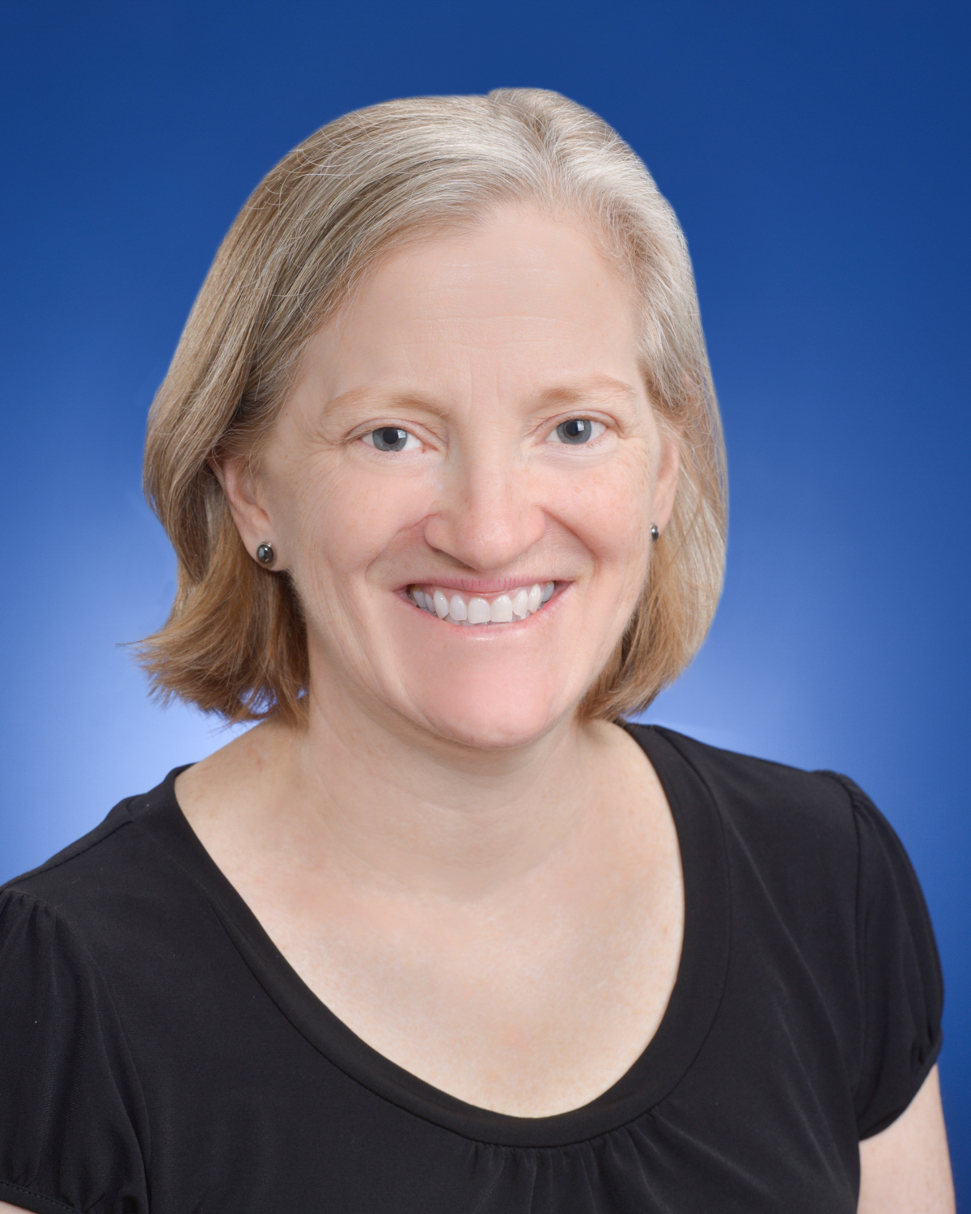
Speaker Introduction – Mary Nilsson
MS degree in statistics from Iowa State University in 1989
Employed at Lilly since 1989
Approximately 8 submissions
Safety Analytics group since 2012 (consults with compound teams on safety analysis planning)
Co-leads the PhUSE Standard Analyses and Code Sharing Working Group
Leads the PhUSE Analysis and Display white papers project team

Slide 3
Acknowledgements
Co-authors and reviewers of the PhUSE white papers
Analysis and Display white papers project team
Nhi Beasley (FDA Liaison)
Wei Wang, Rebeka Revis
Lori VanMeter, Jerry Xu, Swarna Reddy, Brenda Crowe

Slide 4
Pre-reads
The following white papers from the PhUSE Deliverables Catalog are listed as suggested pre-reads:
  AE white paper
  Labs/Vitals/ECGs Central Tendency white paper
  Labs/Vitals/ECGs Outlier/Shift white paper
  Demographics/Disposition/Medications white paper
Additional useful resource:
  FDA 2010 Clinical Review Template (Attachment B, starting on page B-1)
Notes:
How to navigate to PhUSE white papers – Go to phuse.eu, click on Working Groups, click on white papers (Alternatively, go to phuse.eu, click on the Resources tab, click on Working Group Deliverables)

Slide 5
Disclaimer
The opinions expressed in this document are those of the authors and should not be construed to represent the opinions of the Pharmaceuticals User Software Exchange (PhUSE), members' respective companies or organizations, or FDA’s views or policies. The content in this document should not be interpreted as a data standard and/or information required by regulatory authorities.
Notes:
This is the disclaimer included in the PhUSE Analysis and Display white papers.

Slide 6
Agenda
This workshop will be recorded and publicly posted
Background
Definitions and Purpose
Adverse Events
Labs
Medications
Summary
Notes:
We’ll take questions after each topic.

Slide 7


Outline for Adverse Events, Labs, Medications
Discuss recommended tables and figures
  Individual study tables and figures
  Expand on rationale
  Expand on interpretation of tables and figures
  Share common pitfalls
  Cover frequently asked questions
Notes:
While internal guidance documents and PhUSE white papers (pre-reads) include rationale to some extent, we have learned that additional rationale might be helpful to teams.
Integrated summaries – included in PhUSE white papers but out-of-scope for this workshop.

Slide 8
Background for Having a Workshop
There’s a gap in safety analytics knowledge across all functions (including statistics)
Educating during internal team meetings and during regulatory interactions is difficult – one agenda of many, usually during time pressure

Slide 9

Myths
Analytical planning for safety is easy
Interpreting safety results is easy
Notes:
Because there’s a perception that safety planning and safety interpretation is easy, perhaps not all team members are getting sufficient training and/or not setting aside enough time to think through the analytical issues.
Analytical planning is particularly difficult for complex study designs; integrated safety planning is almost never easy (separate educational module planned for integrated summaries).
Interpretation is often hampered by a lack of understanding of the purpose of the display.
A lot has been done, and a lot is being done, to make creating safety analyses easier, but planning and interpreting safety analyses may never be all that easy.

Slide 10
Analysis and Display White Paper (ADW) Project
Lead: Mary Nilsson
FDA Liaison: Nhi Beasley
Description: This project includes the development of white papers that provide recommended Tables, Figures, and Listings for clinical trial study reports and submission documents. The intent is to begin the process of developing industry standards with respect to analysis and reporting for measurements that are common across clinical trials and across therapeutic areas

Slide 11
ADW Project Team Goals
Improve expertise in safety analytics across multiple disciplines involved with planning, interpreting, and reporting safety analyses
  Promote good analytical practices, avoid poor practices
Define a set of recommended tables, figures, listings and associated analyses
  Ensure reviewers receive clinically relevant and meaningful analyses for benefit-risk assessment
  Harmonization leads to efficiencies in both creation and review of analyses
Facilitate cross-functional engagement in analytical planning

Slide 12
ADW – Final Deliverables
All final white papers from the project team are in the Working Group Deliverables Catalog
  White Papers section
Adverse Events (2017)
Vitals Signs, Labs, ECGs
  Central Tendency (2013)
  Outliers/Shifts (2015)
Demographics, Disposition, Medications (2014, 2018)
Non-compartmental PK (2014)
QT/QTc Studies (2016)
Notes:
For this workshop, we’ll cover topics presented in the white papers in the red box, but not all topics. The white papers have more material than what we will cover.

Slide 13
Definitions to Facilitate Discussion
Signal detection – Analyses and displays used to determine which events or changes in labs/vitals/ECGs require further evaluation for adverse drug reaction (ADR) consideration
Signal clarification – Additional analyses and displays used to facilitate the assessment of whether an event or change in labs/vitals/ECGs should be identified as an ADR
Signal characterization - Additional summaries used to characterize events or changes in labs/vitals/ECGs once they are determined to be an ADR
Signal communication - Additional summaries used for documents that communicate ADRs (eg, regional labelling)
Notes:
ADR=Adverse Drug Reaction
Perhaps not everyone will like these terms and definitions, and we’re happy to hear alternatives, but for now they seem helpful to get some points across within the workshop
Signal detection – This terminology isn’t usually used in the clinical trial setting, but seems to be a useful term to distinguish purpose across various analyses
Signal clarification – Sometimes (but not always) additional analyses/summaries are needed to help make a final decision on whether to consider the event/change an ADR.
Signal characterization examples – occurs early vs late, resolves rapidly vs not, transient vs persistent, etc.

Slide 14
Definitions to Facilitate Discussion
Static display – A table, figure, or listing that is created without any interactive features. It is something that can be viewed in its entirety on a page(s).
Interactive display – A table, figure, or listing that allows point-and-click technology to zoom, scroll, hover over a data point to see more information, or control information displayed (eg, choose among odds ratio, risk ratio, risk difference)
Notes:
Definition for static display from PhUSE AE white paper

Slide 15
Convention to Facilitate Discussion
The FDA/EMA/PMDA says”, or “the FDA/EMA/PMDA thinks”
  Let’s reserve this language for when the position is documented in a regulatory guidance document
“Our clinical reviewers asked”, or “some clinical reviewers think”
  Let’s use this language when the position hasn’t been established in a regulatory guidance document
Common Pitfall: Assuming an opinion held by a regulatory reviewer is a commonly held opinion across the agency
Notes:
Recommend using this convention during all your discussions.

Slide 16
Adverse Drug Reaction (ADR) Definition
An undesirable effect, reasonably likely to be caused by a study drug and it may occur as part of the pharmacological action of the study drug or may be unpredictable in its occurrence
Notes:
This definition is from the PhUSE AE white paper, which includes references for the definition.
See also FDA Guidance January 2006 - Adverse Reactions Section of Labeling for Human Prescription Drug and Biological Products — Content and Format

Slide 17
ADR Determination
Common Pitfall: Thinking the list is determined based on some rule (eg, at least 1% and greater than placebo)
Factors used to determine the list of ADRs
  Strength of evidence for an imbalance between study drug and placebo (via p-values or confidence interval, or sometimes the “eyeball” test)
  Magnitude of the observed effect (via odds ratio, risk ratio, or risk difference)
  Observed dose relationship
  Biologic plausibility
  Clinical relevance of any individual case (e.g., any available dechallenge/rechallenge information)
  Severity of the event
  Consistency of findings across studies
  Consistency of findings across similar events
  Consistency of findings across similar compounds
Notes:
ADR=Adverse Drug Reaction
The red text highlights the portions where standard safety analyses apply.
Common pitfall: Sometimes, there’s a tendency to believe ADRs are determined by some rule. Old US labels were created in this manner, but has changed likely after the 2006 FDA guidance. There are some recent examples of US labels having ADR tables with all TEAEs meeting numeric criteria (as opposed to “ADRs” meeting numeric criteria). Currently, we’re unsure why this is the case.
Sources:
CIOMS Working Groups III and V. Guidelines for preparing core clinical-safety information on drugs. 1999, Geneva: Council for International Organizations of Medical Sciences.
FDA Guidance January 2006: Adverse Reactions Section of Labeling for Human Prescription Drug and Biological Products — Content and Format
Crowe B, Brueckner A, Beasley C, Kulkarni P. Current practices, challenges, and statistical issues with product safety labeling. Stat Biopharm Res, 2013, 5(3): 180-193.
Ma H, Ke C, Jiang Q, Snapinn S. Statistical considerations on the evaluation of imbalances of adverse events in randomized clinical trials. Therapeutic Innovation & Regulatory Science, 2015, 49(6): 957-965.

Slide 18
Purpose of Initial Set of Safety Analyses
Signal detection
  Safety topics of interest have separate analysis plans, usually signal detection and clarification
Common Pitfalls:
A-priori creating analyses for all 4 types (detection, clarification, characterization, communication)
Applying what is needed for a safety topic of interest (eg, clarification) to all safety
Applying what is needed for a label (eg, communication) to all safety
Notes:
Thought process – Find events, changes in labs/vitals/ECGs that require further scrutiny (signal detection). Of those, some may need additional analyses to help decide (clarification). Only those identified as dCSI/ADR need to be characterized and communicated.
Note: For some studies (eg, late in a compound’s lifecycle), it’s possible that benefit/risk between an active control and study drug is of more interest and signal detection is of less interest. In these cases, some differences in analytical approach may be warranted.
Common pitfall #1: Sometimes, there’s a tendency to create analyses/summaries for all 4 types of analyses (detection, clarification, characterization, communication) for all events and changes in labs/vitals/ECGs, which is unnecessary.
Common pitfall #2: Sometimes, there’s a tendency to think about what is desired for certain safety topics of interest, and create the planned signal detection plans accordingly. This is not a recommended approach. The plans for special topics of interest can be independent from general signal detection.
Common pitfall #3: Sometimes, there’s a tendency to start with signal communication then create the analyses for signal detection accordingly. Example: Assume competitor labels have 12-week data. There’s a tendency to create 12-week summaries in addition to summaries that include an entire controlled phase. This is not necessary. Signal detection can focus on an entire controlled period, and data can be created for exactly what is needed for a label.

Slide 19
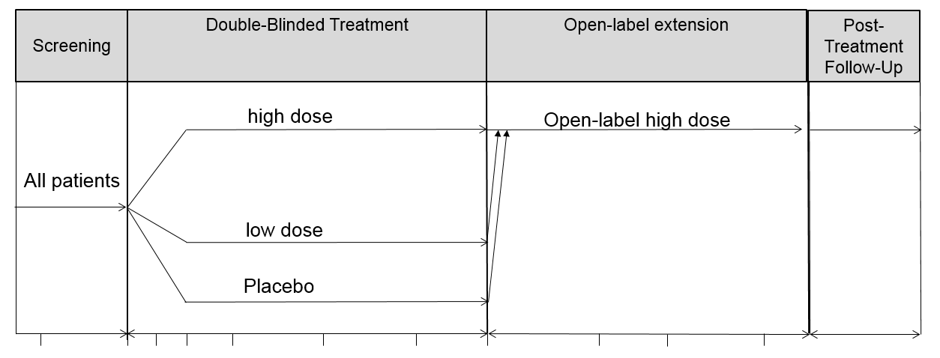
Study Design Used for Discussion
Notes:
We’ll use this example design for our discussion.
Same recommendations will likely apply to most alternative designs. For designs without a controlled period, some of the recommendations will not apply.
For discussion purposes, assume patients discontinuing study drug are encouraged to remain in the study, following the schedule of events as if on study drug (ie, as opposed to immediately entering the follow-up period).

Slide 20
Adverse Events – The List (from AE white paper)
Study Drug vs Placebo
Overview of AEs
TEAEs sorted by PT within SOC
TEAEs sorted by PT
Common TEAEs (eg, ≥1%)
  usually a table but prefer a figure
TEAEs by maximum severity
AEs leading to study treatment discontinuation (PT or PT within SOC)
SAEs (PT or PT within SOC)
During Study Drug and During Study Drug+After
Overview of AEs
TEAEs sorted (PT or PT within SOC)
AEs leading to study treatment discontinuation (PT or PT within SOC)
SAEs (PT or PT within SOC)
Percentages
Notes:
Study drug vs placebo list from the PhUSE AE white paper. Multi-period studies were not in scope.
AE = Adverse Event; PT = Preferred term; SAE = Serious Adverse Event; SOC = System Organ Class; TEAE = Treatment-emergent adverse event
We understand that safety assessment is both a science and an art and individuals have different ways of looking at safety data. However, we are trying to harmonize. As interactive displays become more available, the recommendations may change. Also, as we continue interactive tool development and implementation, we can accommodate more variation, but we would still need to ensure completeness.

Slide 21
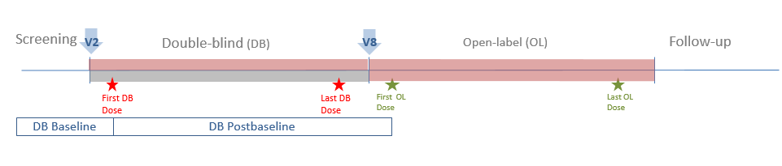
Adverse Events – Time Periods
Baseline: All time before the first DB Dose
Postbaseline: Time from first DB dose to right before OL dose or the summary visit in DB period, whichever comes first

Slide 22
Adverse Events – Time Periods
Lead-in
Double-blind (DB)
Open-label (OL)
Follow-up
Study Drug
First OL
Dose
Study Drug
First OL
Dose
Last OL
Dose
First DB
Dose
Last DB
Dose
Last OL
Dose
Placebo
The above illustrates the cohorts and what part are included in the ‘During Study Drug Treatment and After’ analysis. Both cohorts will be pooled together in the analysis.
Notes:
Study Drug/Study Drug cohort:
Baseline - start of screening and ends prior to the first dose of study treatment
Postbaseline During Study Drug - starts after the first dose of study drug and ends at last visit of OL period or the day of the study treatment disposition visit (whichever is earliest)
Postbaseline During Study Drug+After- starts after the first dose of study treatment and ends when study participation ends
Placebo/Study Drug cohort:
Baseline – Various options, but often defined as time at start of Study Drug
Postbaseline During Study Drug - starts after the first dose of study drug and ends at last visit of OL period or the day of the study treatment disposition visit (whichever is earliest)
Postbaseline During Study Drug+After- starts after the first dose of study drug and ends when study participation ends

Slide 23
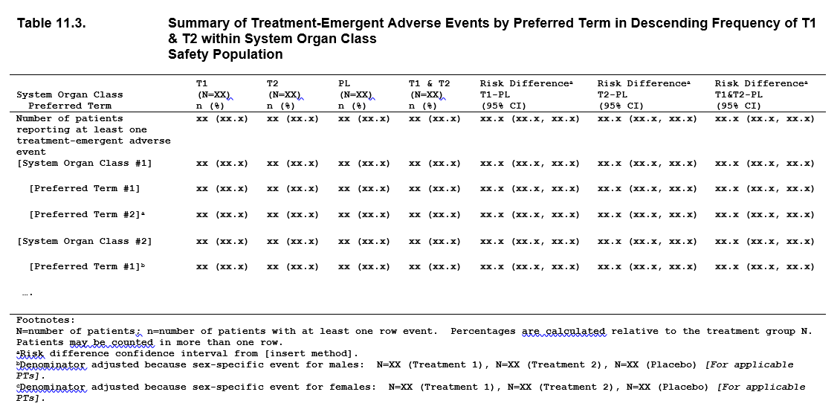
Adverse Events – Treatment Period Shell
T1 = Low dose
T2 = High dose
PL=placebo
Notes:
Think of T1 and T2 as low dose and high dose.
Note: The recommended shells we have today assumes we require “static” TFLs. We live in a “digitized paper” world. Hopefully that changes over time.
Interesting article related to the need for interactive displays – November 2018 Pink sheet article
Link to full article: https://pink.pharmaintelligence.informa.com/PS124255/Reliance-On-Digitized-Paper-Is-Slowing-Drug-Development--US-FDAs-Woodcock
Excerpt:
The US FDA’s Janet Woodcock is issuing a call to action to better leverage technology in drug development and regulatory review, starting with the elimination of “digitized paper.”
Speaking at the Friends of Cancer Research (FOCR) annual meeting in Washington, DC Nov. 13, the Center for Drug Evaluation and Research director suggested that getting drugs to market efficiently is being hindered “by the inability to actually exchange data freely and to really take advantage of the digital age.”
She challenged industry, regulators and other stakeholders to think creatively about how to move away from legacy, paper-based processes in clinical trials and regulatory submissions, in favor of approaches that capitalize on available digital tools.
“We really ought to think about digital technology in a different way,” Woodcock said. “We really ought to think about how can we streamline and actually utilize the digital age in order to most effectively regulate and most efficiently regulate.”
FDA initiatives aimed at getting drugs to market faster can only be so effective when some basic regulatory processes, such as submissions and labeling revisions, are still grounded in paper records, she said.
“My modest proposal is that we all get together … and I commit to working on this – that we think how we can move to really enable the digital age to help clinical investigation and to streamline all these things, and put our assets and our efforts and our people against things that really matter.”

Slide 24
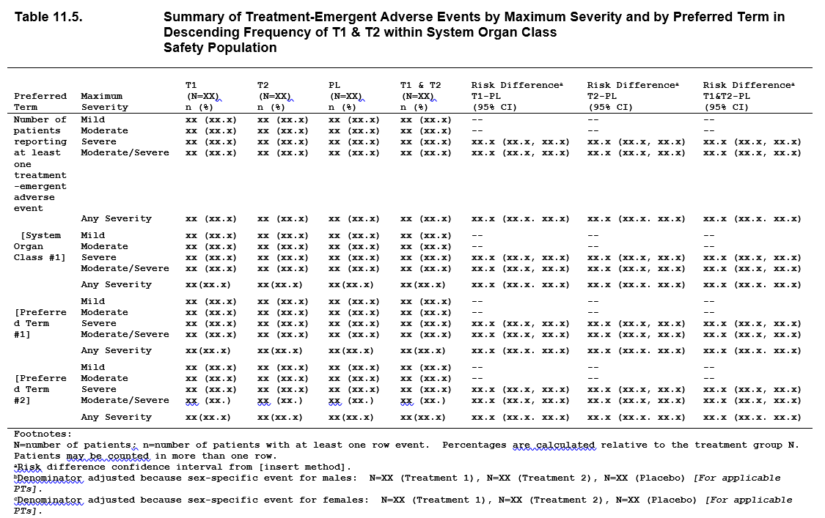
Adverse Events – Maximum Severity Shell
T1 = Low dose
T2 = High dose
PL=placebo
Notes:
Think of T1 and T2 as low dose and high dose.
Note: The recommended shells we have today assumes we require “static” TFLs. We live in a “digitized paper” world. Hopefully that changes over time.
Interesting article related to the need for interactive displays – November 2018 Pink sheet article
Link to full article: https://pink.pharmaintelligence.informa.com/PS124255/Reliance-On-Digitized-Paper-Is-Slowing-Drug-Development--US-FDAs-Woodcock
Excerpt:
The US FDA’s Janet Woodcock is issuing a call to action to better leverage technology in drug development and regulatory review, starting with the elimination of “digitized paper.”
Speaking at the Friends of Cancer Research (FOCR) annual meeting in Washington, DC Nov. 13, the Center for Drug Evaluation and Research director suggested that getting drugs to market efficiently is being hindered “by the inability to actually exchange data freely and to really take advantage of the digital age.”
She challenged industry, regulators and other stakeholders to think creatively about how to move away from legacy, paper-based processes in clinical trials and regulatory submissions, in favor of approaches that capitalize on available digital tools.
“We really ought to think about digital technology in a different way,” Woodcock said. “We really ought to think about how can we streamline and actually utilize the digital age in order to most effectively regulate and most efficiently regulate.”
FDA initiatives aimed at getting drugs to market faster can only be so effective when some basic regulatory processes, such as submissions and labeling revisions, are still grounded in paper records, she said.
“My modest proposal is that we all get together … and I commit to working on this – that we think how we can move to really enable the digital age to help clinical investigation and to streamline all these things, and put our assets and our efforts and our people against things that really matter.”

Slide 25
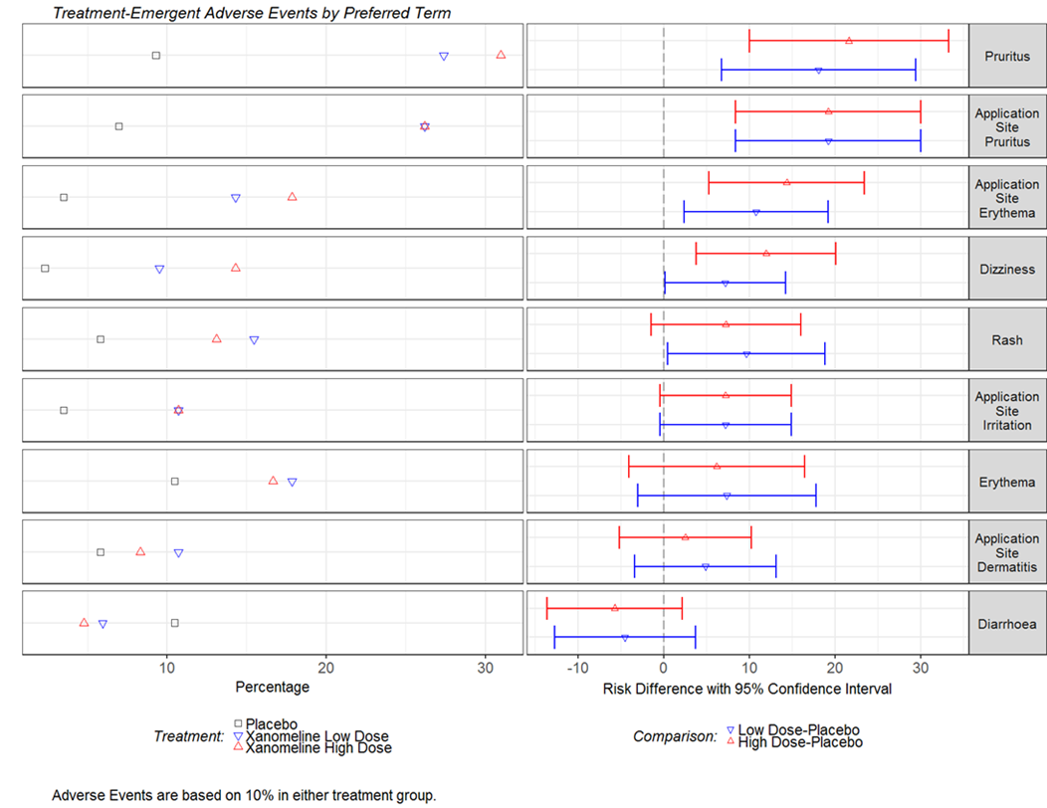
Adverse Events – Treatment Period Shell

Slide 26
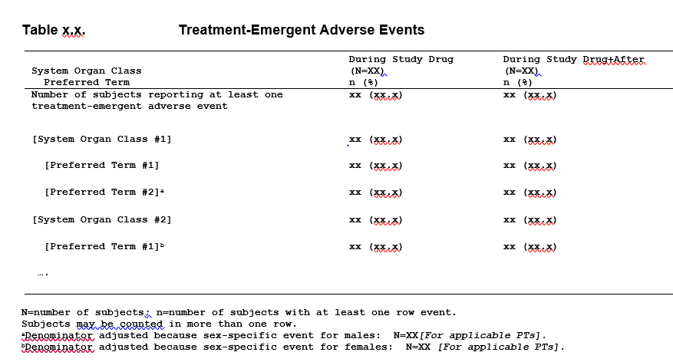
Adverse Events – During Study Drug and During Study Drug+After

Slide 27
Adverse Events – Rationale
During Study Drug and During Study Drug+After
Study Drug vs Placebo
  During SD: Provides a way to see all events – looking for the more rare events, and late onset events that might require case reviews
  During SD+After: Same as During SD except takes the conservative approach by assuming any event after treatment could be due to treatment
  Provides strength of evidence for an imbalance with placebo and magnitude of effect (part of ADR determination)
Notes:
ADR=Adverse Drug Reaction
During Study Drug and During Study Drug+After: looking for events with potential clinical consequences (high likelihood of leading to permanent disability or death) that thoughtful consideration should be applied to decide whether the event should be considered an ADR despite limited data.

Slide 28
Adverse Events – Rationale
Table | Rationale
Overview of AEs | Provides a nice summary for CSR purposes
TEAEs sorted by decreasing frequency across PTs within SOC | Used to look for events with strong evidence for an imbalance, high magnitude of effect, or noteworthy based on clinical judgment
TEAEs sorted by decreasing frequency across PTs | Same as above, but offers a different way of sorting
Common TEAEs sorted by decreasing frequency across PTs | We don’t really have a scientific rationale, but templates call for this
TEAEs by maximum severity | Including all events can obscure a meaningful signal – looking at severe events only provides another chance for finding a signal
AEs leading to study treatment discontinuation (one sort) | Same as TEAEs, max severity
SAEs (one sort) | Same as TEAEs, max severity

Slide 29
Adverse Events - Rationale
TEAEs by maximum severity
  See the FDA Clinical Review Template for a discussion on the potential for missing signals when looking at all severities for events with high background rates
Common Pitfall: Using the maximum severity table for signal characterization only and not review the full table in the context of signal detection, and not include a signal-detection related statement in CSRs
Notes:
TEAE=Treatment emergent adverse event; CSR=Clinical Study Report
Common pitfall – There’s a tendency for teams to use the max severity table for signal characterization only (eg, most events were mild), and not comment on its purpose pertaining to signal detection.
Max severity - from 2010 Clinical Review Template:
Also, in general, tables should give rates for all severities of a given effect, although in some cases (notably cytotoxic drugs), it is important to distinguish more and less severe reactions, as the former may be therapy-limiting or may affect the overall risk-benefit conclusion for the drug. However, for events with high background rates (e.g., headache, fatigue, and other events that occur frequently independent of drug therapy), display of all reported events can result in a high event rate that obscures drug-relatedness. This result can be a particular problem when time on drug is prolonged. For example, it is common for clinical trials of 4 to 6 weeks duration to report headache at a high rate (20 to 25 percent). In that case, considering the severity or causality assessment of such events may allow a better assessment (e.g., if severe headaches are found only in the drug-treated group).

Slide 30
Adverse Events - FAQs
How is treatment emergence defined?
  See Section 10.2 of the PhUSE AE white paper for a brief discussion and references
  Recommending a specific definition is out-of-scope for the AE white paper and this workshop
  Planned for a future white paper
Common Pitfall: Assuming your way of defining treatment emergence is predominant practice

Slide 31
Adverse Events - FAQs
Why do we count the number of patients with events instead of number of events?
  Simpler, works fine in most cases
  Variability in event collection (eg, each headache versus “intermittent headaches”) complicates interpretability of number of events
  Counting events is likely warranted for some safety topics of interest (eg, hypoglycemia, infections), but generally not warranted as part of signal detection
Notes:
Collection of events – Some sites might enter each headache, others may say “intermittent headaches”
Note: Number of events is needed for CT Registry

Slide 32
Adverse Events - FAQs
Why is the list for During Study Drug and During Study Drug+After shorter?
  Common TEAEs – The During SD group is more about the more rare AEs; need to look at all events; sub-setting on common is not value-added for the During SD group
  Max Severity – Included in the placebo-controlled group primarily to compare severe PTs between SD and placebo as part of signal detection
  Time to study treatment discontinuation due to AE – Not as useful without a comparator
Notes:
TEAE=Treatment emergent adverse event; AE=adverse event; PT=preferred term; SD=Study Drug
Common TEAEs – Not all that useful for the placebo-controlled group, but expected per CSR templates

Slide 33
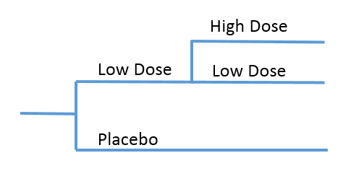
Adverse Events - FAQs
Why isn’t dose included in the During Study Drug summary?
  Dose relatedness is best assessed from the initial treatment period in which randomization is preserved
  Due to channeling bias, summaries by dose including data across periods often lead to misleading interpretations about dose relatedness
    In many designs, randomization is no longer preserved, and biases are usually substantial enough such that summaries are illogical (based on a lot of shared learning)
Common pitfall: Thinking it’s value-added to create summaries by dose using data across multiple periods of a study
Notes:
Considering an extreme example of a study where subjects can titrate up to higher doses if lower doses aren’t working, high dose tends look better than low dose. Only those who can tolerate low dose get to high doses.
Creating exposure-adjusted incidence rates instead of percentages does not solve the issue of channeling bias.
Channeling bias – A term usually used in the observational study setting, where “sicker” patients are often prescribed the newer medications creating bias when comparing newer versus older medications.

Slide 34
Adverse Events - FAQs
Why have confidence intervals or p-values?
  Having a measure assessing strength of evidence for an imbalance is helpful and is part of ADR determination
  For safety, think of p-values as an assessment of strength of evidence for an imbalance, using a scale from 0 to 1
    Not used for hypothesis testing
  Confidence intervals provide a means for assessing strength of evidence for an imbalance, but not as easy to use for “ranking” strength and/or facilitating consistent thinking for events with similar strength
Common pitfall: Focusing on events with p-values less than a specified value (eg, 0.05) or confidence intervals that don’t include 0 (for risk differences) or 1 (for risk ratio, odds ratio)
Notes:
ADR=Adverse Drug Reaction
This is a frequently asked question!
Many companies do not include p-values with their safety summaries. For these companies, they likely look at magnitude of effect as an approximation for strength of evidence for an imbalance.
Without p-values or confidence intervals, it’s possible that the events with strong evidence for an imbalance but relatively lower magnitude of effect will get less attention that they may deserve. Including p-values or confidence intervals is a means to help ensure these events aren’t lost in the shuffle.

Slide 35
Adverse Events - FAQs
Strength of evidence for an imbalance and magnitude of effect are not the same
  Example: Odds ratios are the same, p-values are different
Event | Study Drug | Placebo | OR | P-value
PT 1 | 700/1500 (46.7%) | 550/1500 (36.7%) | 1.5 | <.001
PT 2 | 41/1500 (2.7%) | 27/1500 (1.8%) | 1.5 | .110
Notes:
OR=Odds ratio
While the magnitude of effect is the same between these 2 PTs, the strength of evidence for an imbalance is not the same.

Slide 36
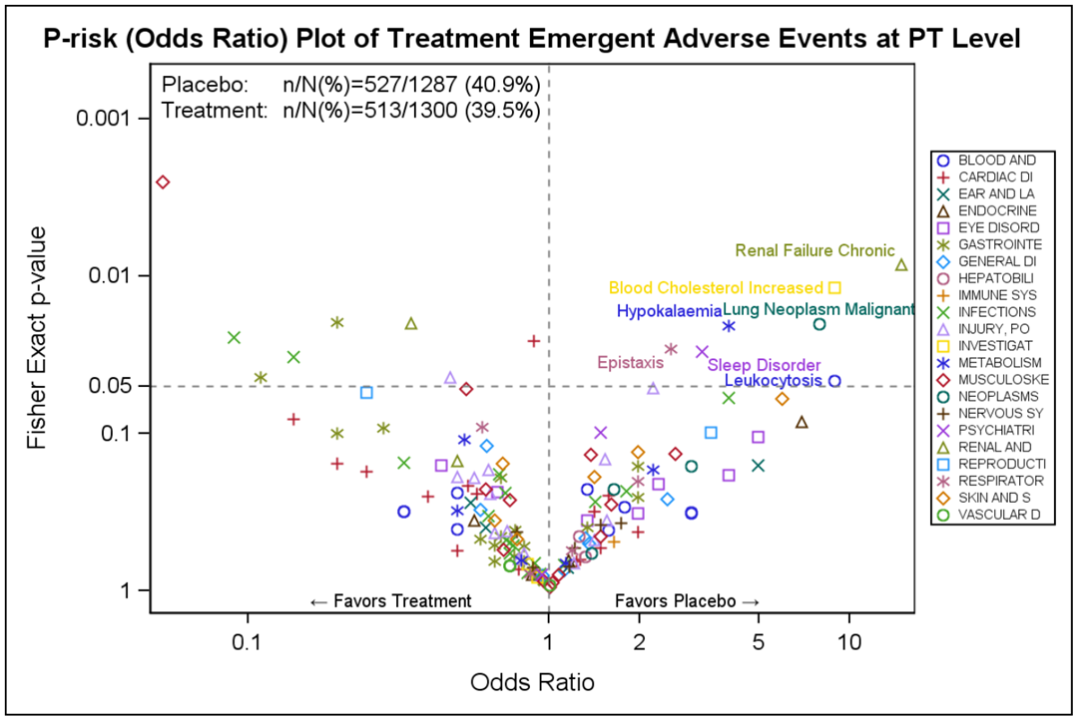
Volcano Plot – Shows both strength of evidence for an imbalance and magnitude of effect
Notes:
Volcano plot copied from CTSpedia. While the main focus of the presentation is to go over our recommended displays, we’ll deviate from that at the moment.
Volcano plot on cover of the book “Quantitative Evaluation of Safety in Drug Development”, and discussed in the Safety Graphics chapter.
Also included in: Ma H, Ke C, Jiang Q, Snapinn S. Statistical considerations on the evaluation of imbalances of adverse events in randomized clinical trials. Therapeutic Innovation & Regulatory Science, 2015, 49(6): 957-965.

Slide 37
Adverse Events - FAQs
Why does postbaseline end at the study treatment disposition visit (for those who discontinue)?
  Conceptually, it shouldn’t
    Estimating the percent of patients with an event during the treatment period would suggest all data during the treatment period should be included
  However, in practice, it seems patients are allowed to take other medications once study treatment is discontinued
  For signal detection purposes (study drug vs placebo), the bias created by the addition of events potentially due to other medications is usually considered worse than the bias created by excluding events occurring during the time between study treatment discontinuation through the end of the treatment period.
Notes:
There’s a list of principles in the PhUSE AE white paper about time post study drug.
Estimand guidance has been recently published, but pertains mostly to efficacy. The concept also applies to safety. Further thought on this is ongoing.
In some studies, patients who discontinue study treatment are immediately moved to the follow-up period. This issue is moot for these studies.
If a study does not allow other medications, using the entire treatment period would be recommended. This is an example of why safety isn’t always easy. All of these considerations are important in safety analysis planning.
The bias created by including time between study treatment discontinuation and end of treatment period – Placebo patients who discontinue and take other medications could have events caused by the other medications. These would be attributed to placebo and signals could be missed.
The bias created by excluding time between study treatment discontinuation and end of treatment period – Not really an issue when used for signal detection unless there is substantial differences in time of observation between SD and placebo. Could be an issue for signal communication – If discontinuations rates are high, the percentage would be under-estimated.

Slide 38
Adverse Events - FAQs
Why didn’t you add 30 days (or some other number based on the half-life of the compound) to the placebo-controlled analysis?
  Usually interested in estimating the percent of patients with an event after x weeks of treatment (where x is the length of the treatment period)
  If 30 days were added, you’re estimating the percent of patients with an event after x weeks of treatment plus 30 days off treatment
  In the example design, if 30 days were added to both study drug and placebo, study drug events would attributed to placebo. You could exclude events occurring after switching to another drug, but that introduces bias by doing something to one arm and not the other.
Common Pitfall: Assuming a convention for adding days is predominant practice
Notes:
There’s a list of principles in the PhUSE AE white paper about time post study drug.
For designs that have a controlled treatment period, immediately followed by a follow-up period, estimating the percentages across the study is a reasonable option. If days are added, should be clear in any communication (eg, label).
This is one area of a lot of variation in thought – some researches would say “of course you want to estimate percentages for just the treatment period”; other researchers would say “of course you should include events beyond the treatment period”. (I believe that people with past neuroscience experience tend to fall in the first category as past products had events associated with discontinuation, and people with past oncology experience tend to fall in the latter category as simple designs are relatively normal.)

Slide 39
Adverse Events - FAQs
Common Pitfall: For safety analyses, choosing the most conservative approach across various choices
Conservative from a total count perspective may lead to being less conservative from a treatment difference perspective
To assess treatment differences, recommend making analytical decisions that lead to the least amount of bias
Notes:
See “Conservativeness” sections in white papers.
Section from AE white paper:
The focus of this white paper is clinical trials for which there are comparator data (either placebo or active comparator). One might be tempted to consider that it is always “conservative” to choose a method that leads to a higher number of patients being included in an analysis. This could be achieved in various ways, such as including a long post-drug follow-up time, using a low boundary as the upper reference limit for a laboratory value, or using a broad search for AE terms to ensure that all possible relevant terms are included in the definition of the safety outcome. However tempting these approaches may be, they can sometimes make it more difficult to identify safety signals in a comparison of drug to a comparator [8, 37, 38]. This is because overly broad inclusion of events (or patients with an event) can lead to an underestimation of the true relative risk because more events may be included in each arm that are unrelated to the true, but possibly unknown, mechanism of action, thus adding spurious “events” to each arm in the analysis.
In other words, it is not necessarily “conservative” to add more data, if the resulting estimate introduces bias and/or spurious findings that could dilute a signal. The intent of the proposed methodology is to identify meaningful safety signals for a treatment relative to a comparator group.

Slide 40
Adverse Events - FAQs
Why don’t you have analyses for the OL period by itself, and the follow-up period by itself?
  If data are presented by period, it makes it more difficult to find the more rare events that warrant further scrutiny
  Unless the compound has withdrawal effects, a summary of the follow-up period by itself isn’t usually associated with an estimate of interest
    There’s a better way to assess withdrawal effects
    There’s a better way to characterize events after stopping treatment
Common Pitfall: Plan for all safety analyses by period for all periods
Notes:
OL=Open label
Common pitfall: Plan for all safety analyses by period for all periods (Identified as a contributing factor in unnecessary volume of tables and figures.)

Slide 41
Adverse Events - FAQs
Why didn’t you include exposure-adjusted incidence rates?
  For controlled periods, we don’t usually have differential observation time, so exposure-adjustment isn’t usually warranted
  For During Study Drug, exposure-adjusted incidence rates might be useful, but we recommend the additional summaries for integrated only
Common Pitfall: Thinking that exposure-adjustment is a complete solution for taking care of differences in observation time
Common Pitfall: Under-appreciation that exposure-adjusted incidence rates can perform poorly for events that mainly occur early
Common Pitfall: Creating exposure-adjusted incidence rates that includes off-treatment time
Notes:
For long-term controlled studies, exposure-adjustment is sometimes warranted. However, a time block approach might be even better.
We’ll discuss more in the integrated module, but the combination of adding off-treatment time and exposure-adjustment is not recommended (as noted in the PhUSE AE white paper). Also, exposure-adjusted summaries assume constant hazard.

Slide 42
Adverse Events - FAQs
Why do some compound teams use subjective severity levels (mild/moderate/severe) when CTC objective levels can be used?
  See the PhUSE AE white paper for a discussion
  Developed for oncology since oncology patients experience many adverse events and such severity granularity is considered useful
  For most indications, subjective severity levels seem sufficient (and considered less burdensome)
    Knowing seriousness and knowing whether the event led to treatment discontinuation are additional indicators of severity
Notes:
CTC = Common Terminology Criteria
From PhUSE AE white paper:
It appears that for most nononcology studies, severity is collected subjectively as mild, moderate, or severe, and for most oncology studies, severity is collected more objectively using CTCAE grade definitions with 4 or 5 levels for some terms. Standardized CTCAE severity levels were developed for oncology studies since oncology patients experience many AEs and such severity granularity is considered useful. Since the development of CTCAE severity levels, some have suggested that it should be used beyond oncology, with the idea that having more severity levels with objective criteria would be more useful than three subjective levels. Alternatively, others have suggested that collection of severity level is not useful with the idea that knowing seriousness and knowing whether the event led to treatment discontinuation are sufficient indicators of severity. In general, we do not recommend the added burden to use CTCAE severity definitions in nononcology indications, except perhaps for specific AESIs, if applicable.

Slide 43
Adverse Events - FAQs
Why didn’t you include a summary of AEs considered related by the investigator?
  Assessments by investigators are highly dependent on information available at the time of the clinical trial (eg, what is in the investigator’s brochure)
  Thus, it’s generally not useful to use their assessment as part of signal detection
    Could be useful in the review of individual cases for signal clarification
Notes:
AE=adverse event
From FDA Clinical Review Template.
See also a section in the PhUSE AE white paper on this topic. There’s CIOMS guidance that proposes to not even collect this information, except for SAEs (reference in the PhUSE AE white paper).
Note: Summaries of AEs considered related by the investigator are recommended for EU layperson summaries (ie, plain language summaries). The authors of the guidance believe these summaries are useful when communicating findings from a study. Summaries of AEs considered related by the investigator generally included in Japan labels.
Excerpts from the FDA Clinical Review Template:
It is important to distinguish the processes described above from the causality analyses of drug-related events often provided by investigators and applicants in NDA/BLA submissions. The analyses of drug-related adverse events presented by applicants are usually based on assessments made by investigators at the time of an event, are highly dependent on information about the side effect profile of the drug available at the time of the clinical trial (e.g., what is in the investigator’s brochure), and are not informed by awareness of the entire safety database. Generally, these analyses are not expected to provide much useful information in assessing causality and should be disregarded.
Data are often available on the investigator’s opinion regarding whether or not any particular adverse event was in fact related to the drug being taken. Some reviewers consider this useful information and may construct tables that include only those events considered possibly, probably, or definitely drug-related by the investigator. Others ignore such judgments and include all reported adverse events, with the view that the control groups, especially placebo if present, should permit one to make causality decisions, regardless of the investigator’s judgments about drug-relatedness. Either approach is acceptable, but it is critical that a footnote indicate when adverse events are not included because of the investigator’s judgments that they were not drug-related, since this approach may reduce the adverse event rates that appear in the table.

Slide 44
Adverse Events - Interpretation
Study Drug vs Placebo comparisons
  Confidence intervals and p-values provide an assessment on how strong the evidence is for an imbalance – NOT used to assess statistical significance
  See March 2019 special issue of The American Statistician
    Moving to a world beyond p<0.05
    As “statistical significance” is used less, statistical thinking will be used more
Common Pitfall: Statements such as “The percentage was higher in study drug vs placebo, but the confidence interval included 1”
Notes:
Common pitfall: Strength of evidence for an imbalance and magnitude of effect are key for frequent events, less useful for rare events. The other items listed on the ADR Determination slide become more important. I don’t believe we’re over-using p-values when deciding if an event/change is an ADR, but our writing style might suggest otherwise.
While we want to stop referring to statistical significance, that doesn’t mean we suggest excluding confidence intervals or p-values from displays. It’s about how we use them. Statistical thinking is still important.

Slide 45
Adverse Events - Interpretation
During Study Drug and During Study Drug+After data
  With additional exposure time, there is more opportunity to see more of the rare or late onset events that could require further scrutiny for ADR determination
  Interpretation is primarily based on medical judgment, with knowledge of the population, knowledge of the design, length of study, and case reviews
  During Study Drug+After interpreted as conservative count (attributes an event after study drug to study drug)
Common Pitfall: Comparing During Study Drug percentages or exposure-adjusted incidence rates with placebo-controlled percentages
Notes:
Percentages need to be interpreted with the concept of time. Placebo-controlled data compares an estimate of a particular event within in a particular time (eg. 12 weeks). During LY is an estimate of a particular event usually within a much longer period of time (eg., 52 weeks). An estimate for 52 weeks should not be compared with an estimate for 12 weeks.
We do recommend a display incorporating exposure-adjustment for integrated data intended to help put All Study Drug into perspective. However, it can still be biased as it assume constant risk over time which is often not the case (eg, usually seen less frequently).
Conservative is this context is OK – We’re not comparing treatment with control. We’re looking for events that require further scrutiny, which will likely include review of individual cases.

Slide 46
Adverse Events - Interpretation
Concept of primary
  Unlike efficacy, defining a primary safety analysis set is not needed
    Placebo-controlled data will be the most useful for the more common events
    Longer-term data will be the most useful for late onset and the more rare events
Common Pitfall: Identifying a primary safety analysis set
Notes:
Percentages need to be interpreted with the concept of time. Placebo-controlled data compares an estimate of a particular event within in a particular time (eg. 12 weeks). During LY is an estimate of a particular event usually within a much longer period of time (eg., 52 weeks). An estimate for 52 weeks should not be compared with an estimate for 12 weeks.
We do recommend a display incorporating exposure-adjustment for integrated data intended to help put All Study Drug into perspective. However, it can still be biased as it assume constant risk over time which is often not the case (eg, usually seen less frequently).
Exception – Studies that are specifically designed to address a particular safety outcome (CV outcome study)

Slide 47
Adverse Events - Interpretation
Discuss events that are noteworthy based on clinical judgment, have strong evidence for an imbalance, or high magnitude of effect
    The ADR determination factors can be considered for the discussion, however a lot of discussion is most appropriate for an integrated summary
      For individual studies, only need conclusions for the study, not for the compound
Common Pitfall: Focus discussion on common events
Notes:
ADR=Adverse Drug Reaction; CSR=Clinical Study Report

Slide 48
Adverse Events - Interpretation
Be aware of splitting
  From FDA Clinical Review Template 2010: The reviewer should consider the following:
    Whether the terms are too narrow (splitting), resulting in an underestimation of the true incidence for a particular event or syndrome (e.g., somnolence, drowsiness, sedation, and sleepiness probably all refer to the same event)
  “Clustering” or “Consolidation” is recommended at time of integrated summaries
Notes:
Why we consolidate/cluster events (usually in integrated summaries)
One example: insomnia, early insomnia, intermittent insomnia, late insomnia

Slide 49
Adverse Events - Interpretation
Be aware of lumping
  From FDA Clinical Review Template 2010: The reviewer should consider the following:
  Whether the terms are too broad or over-inclusive (lumping), so that important events that should be examined separately are diluted by less important events (e.g., loss of consciousness and syncope subsumed under hypotensive events or hypotension)
    Review of event descriptions during trial level safety reviews is key
Common Pitfall: Lack of appreciating the importance of reviewing event descriptions for specificity, and sending site queries where needed

Slide 50

Questions?

Slide 51
Labs – The List (from labs white papers)
Study Drug vs Placebo
During Study Drug and During Study Drug+After
Shifts to high/low (performing lab limits)
Scatterplots
  Minimum values
  Maximum values
Boxplots over time
  Observed
  Change (includes change to last)
Shift tables
  Minimum values
  Maximum values
  Shifts to high/low
Not all displays would need to go in the CSR
Some displays could be created via an interactive tool
Notes:
CSR=Clinical Study Report
Study drug vs placebo list - From the 2 labs/vitals/ECGs white papers. Multi-period designs were not in scope.
Message from adverse events also applies to labs: We understand that safety assessment is both a science and an art and individuals have different ways of looking at safety data. However, we are trying harmonize. As interactive displays become more available, the recommendations may change. Also, as we continue interactive tool development and implementation, we can accommodate more variation, but we would still need to ensure completeness.

Slide 52
Labs – Common Pitfalls
Creating summaries for all labs in the database (as opposed to just those intended for group-level summaries)
Creating summaries for labs collected in a reflex manner
Creating summaries for labs in which we only receive abnormalities
Lesson learned: If summaries are warranted for labs in which we only receive abnormalities (cell morphology, urine microscopic exam), special data derivations are required (eg, to impute normal records)
Notes:
Common pitfall: There’s a tendency to create these summaries for all labs in the database. Teams (usually in a PSAP) should provide clarity on which labs are intended for group-level summaries versus for individual care/review purposes.
Labs in which we only receive abnormalities – We usually don’t need summary data
Reflex manner, excerpt from PhUSE white paper:
Measurements Collected in Reflex Manner
In study designs, it is possible to have some measurements collected only when another measurement meets a certain criteria (i.e., collected in a reflex manner). For example, sometimes a peripheral smear is only performed when certain complete blood count analytes meet a specified threshold. How to handle such measurements should be specified in analysis planning, which requires an understanding of collection practices. Generally, measurements collected in a reflex manner would be used for individual patient management and possibly for individual patient listings or individual case descriptions (e.g., as included in patient narratives). Summaries of such measurements within or between treatment groups tend to be uninterpretable because you cannot generally assume normality among those who did not have the measurement, and a summary among those meeting the criteria for receiving the measurement (sometimes a small denominator) tends to not be helpful for signal detection purposes.

Slide 53
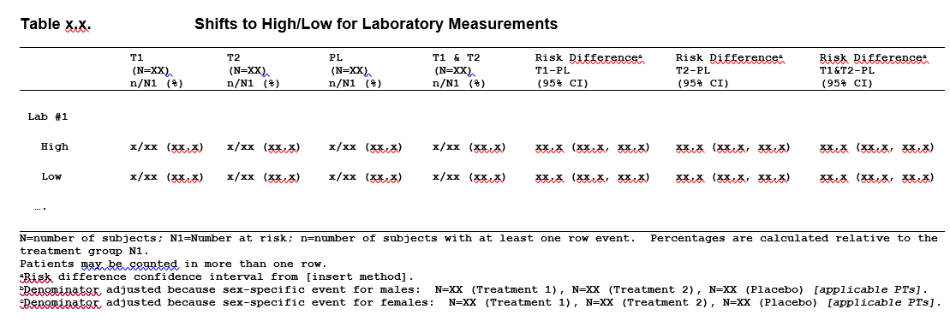
Labs – Treatment Period Shell
T1 = Low dose
T2 = High dose
PL=placebo
Notes:
Think of T1 and T2 as low dose and high dose.

Slide 54
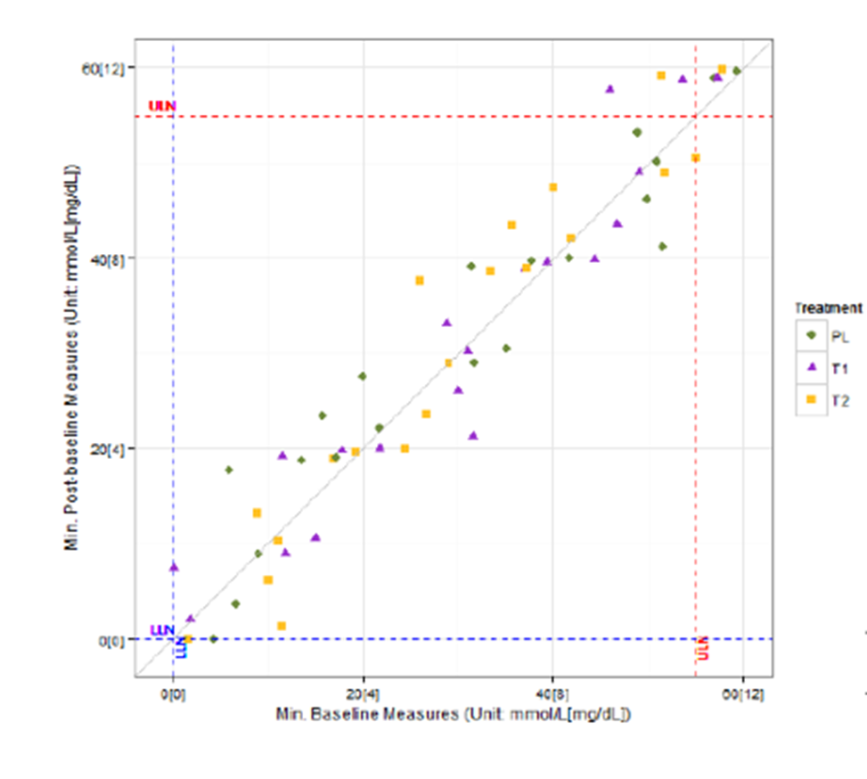
Labs – Treatment Period Shell - Scatterplot
Both SI and CN units can be included in legend
T1 = Low dose
T2 = High dose
PL=placebo
Notes:
Planned and unplanned measurements
Tells you how high is high, how low is low, etc.
Can identify patients of interest
Best created with interactive features

Slide 55
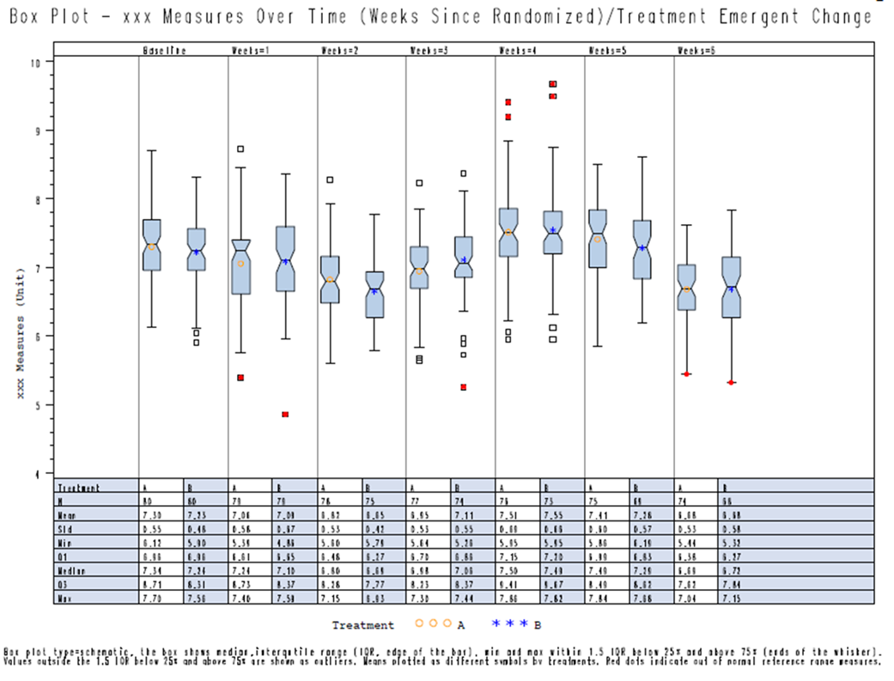
Labs – Treatment Period Shell - Boxplot
Both SI and CN units can be included in legend
Summary table –
SI units
Common pitfall: Forget to keep only planned measurements
Notes:
CN in legends – Not a separate display unless asked by a regulator
There are many versions of a boxplot

Slide 56
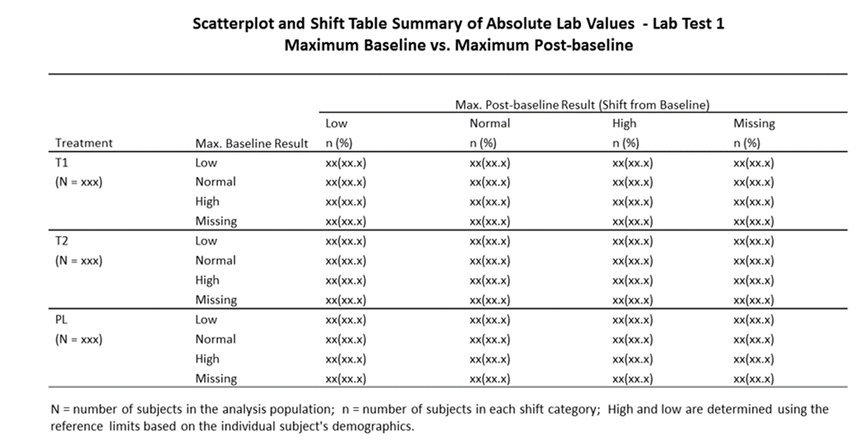
Labs – Treatment Period Shell – Shift Table
T1 = Low dose
T2 = High dose
PL=placebo
Notes:
While we don’t think this table has a lot of value, a lot of people seem to like this. It does have the advantage of having a way to handle missing baselines.
Planned and unplanned measurements

Slide 57
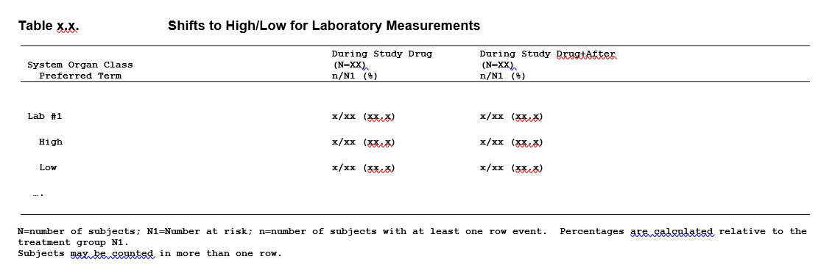
Labs – During Study Drug and During Study Drug+After
Notes:
Sometimes called treatment-emergent high/low
Planned and unplanned measurements

Slide 58
Labs - Rationale
Part of ADR determination (same as adverse events)
Need both central tendency and outlier/shift for controlled portion of the study
  Outlier/shift most helpful, but could miss signals without central tendency
    2010 FDA Clinical Review Template – uric acid, electrolyte levels provided as examples
Notes:
ADR=Adverse Drug Reaction; PhUSE=Pharmaceutical User Software Exchange
Central tendency example from FDA Clinical Review Template 2010:
For example, several drugs that cause modest decreases in uric acid because of a uricosuric effect have caused acute renal failure in inadequately hydrated patients (e.g., ticrynafen, suprofen). Suprofen was withdrawn from the market for this reason. Mean changes in electrolyte levels can also signal risks.

Slide 59
Labs - Rationale
Table/Figure | Rationale
Shift to high/low | Used to look for shifts with strong evidence for an imbalance, high magnitude of effect, or noteworthy based on clinical judgment
Scatterplot | Easy to see extreme values; can visually see patients contributing to TE high/low and how much they are shifting, can determine if there’s a clustering just under a performing lab limit that would be worth exploration
Boxplot | Of the many options for displaying changes in labs in a central tendency manner, this seems to be a good choice as visually seeing changes over time is desirable, and can visually see extreme values
Shift table | Not considered key to signal detection, but currently recommended due to its popularity; may be removed from recommendations in the next version of the PhUSE white paper
Change to last observation | Not considered useful to signal detection, but currently part of predominant practice; may be removed from recommendations in the next version of the PhUSE white paper
Common pitfall: Considering change to last observation as part of signal detection
Notes:
TE=treatment emergent; PhUSE=Pharmaceutical User Softward Exchange
Common pitfall: It’s a common practice to include change from baseline to endpoint summaries as part of signal detection – It’s really not useful for signal detection. A compound that causes a change that occurs early then returns to normal is still an ADR. It’s not all that useful for signal characterization (eg, transient vs persistent) either (unless all/most patients complete). It might be useful for signal communication.

Slide 60
Labs - FAQs
Why do we have to look at so many displays for lab signal detection?
  Most summaries have a purpose
    Some are recommended due to a perceived high risk of being asked as part of a regulatory request if not produced
  Ongoing thought on how to focus/improve (version 2 of the white paper in progress)
  Plans for lab collection and analysis can evolve across the lifecycle of a compound
    See the FDA 2016 late stage guidance
Reminder - Not all displays would need to go in the CSR
Notes:
CSR=Clinical Study Report
While a lot of thought has gone into recommended displays for labs, there is room for additional improvement and innovation. In particular, when we are able to share interactive displays, that will impact what is recommended for static displays. Happy to hear suggestions for improvement.

Slide 61
Labs - FAQs
For the treatment periods summaries, why does the scatterplot and shift table use max/min baseline instead of alternative choices?
  Tempers the impact of within-patient variability
  Using all measures prior to treatment (usually 2), instead of the last or average, tempers the impact of having more measures during treatment
  Aligns with Lilly’s treatment-emergent adverse event definition
    Compares max severity during treatment with max severity during baseline/screening
Notes:
Common choices for baseline include max/min, last, or average. Max/min is recommended for signal detection.
See also PhUSE white paper central tendency (Section 8.3) – While the discussion pertains to changes to min/max, the logic still applies to the scatterplot and shift table.

Slide 62
Labs - FAQs
Since efficacy data are usually analyzed using MMRM, why aren’t you recommending MMRM for safety?
  Primary efficacy analyses often use MMRM to estimate a mean difference at the end of the treatment period
    Safety not interested in estimating this
  If done, would use MMRM to look for group average differences over time, but alternatives seem more reasonable
    Change to max/min seems to fit signal detection better (part of integrated recommendations), and allows the inclusion of unplanned measurements
    Could be considered for labs of special interest (signal clarification)
Notes:
MMRM = Mixed-Effect Model Repeated Measure

Slide 63
Labs - FAQs
Why do you exclude unplanned/unscheduled labs from the boxplots?
  For any display over time, it’s easier to see trends over time without the disruption of a few visits with very few patients
  Inclusion of such data could create bias toward normality
  See Section 10.3 of the PhUSE outliers/shifts white paper for further discussion
Notes:
Excerpt from outlier/shifts white paper:
Planned versus Unplanned Measurements
One topic that tends to be unique to safety (the laboratory analyte measurements in particular) is the collection of unplanned measurements. Unplanned safety measurements can arise for various reasons. During a study, the clinical investigator sometimes orders a repeat test, or retest, of a laboratory test, especially if he/she has received an unexpected value. The investigator may also request the patient return for a follow-up visit due to clinical concerns. In general, retests are repeat tests performed because an initial test result had an unexpected value. The repeat result may either confirm the initial test results or (less commonly) suggest that a laboratory error occurred in the case of the initial result. Retests are often performed to verify that the action taken by the investigator (e.g., changing the dose of study drug as allowed by the protocol) has the desired effect (e.g., test results have returned to within reference limits). If such retests are conducted until desired measurement results have been reached, analyses from baseline to last observation would be biased toward normality. Thus, we recommend including only planned measurements when creating displays or conducting analyses over time and when assessing change from baseline to endpoint. However, we recommend including planned and unplanned measurements for analyses that focus on outliers or shifts across an entire period because these are intended to focus on the most extreme changes.

Slide 64
Labs - FAQs
Why worry about CN units? Hasn’t the research community aligned on SI units?
  Collection and analysis would be so much easier if all physicians were used to the same units!
    Unfortunately, that does not reflect reality
    See a 2013 FDA letter on the topic
    Having different units creates a very complicated data flow from collection through analysis (eg, when to round, precision in rounding, units for limits, order of when to compare with limits)
      We are constantly learning and adjusting standards
      It’s painful, but we’re stuck with this pain
Notes:
CN=convential; SI=standard
This is a frequently asked question from statisticians

Slide 65
Labs - Interpretation
Most topics discussed for AEs apply to labs
Boxplots
  When assessing clinical significance of a shift in a mean, more thought is needed than thinking about what that change might mean for an individual patient
  Not reliable for transient versus persistent assessments
    Spaghetti plots are useful for this
Common pitfall: Considering a result as not being clinically meaningful by reflecting on whether the change would be meaningful for an individual
Common pitfall: Using group means to assess persistent/transient patterns
Notes:
AE=Adverse event
Common pitfall: It’s a common practice to include change from baseline to endpoint summaries as part of signal detection – It’s really not useful for signal detection. A compound that causes a change that occurs early then returns to normal is still an ADR. It’s not all that useful for signal characterization (eg, transient vs persistent) either (unless all/most patients complete). It might be useful for signal communication.
Common pitfall: When reviewing mean changes between treatment and control, there’s a tendency to assess clinical significance as if the difference is within an individual patient. A difference of x might not be meaningful at all for an individual patient, but shifting an entire population by x might be very meaningful. Clinical significance usually requires the review of the entire analysis package.

Slide 66
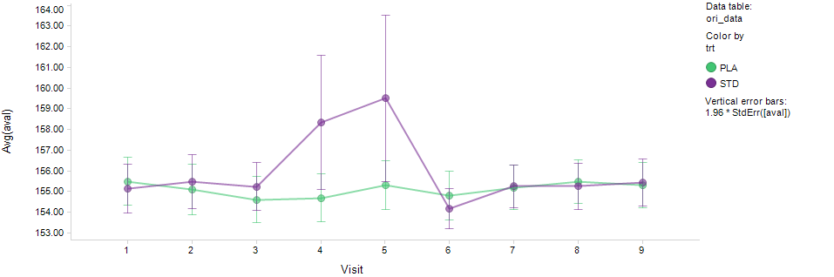
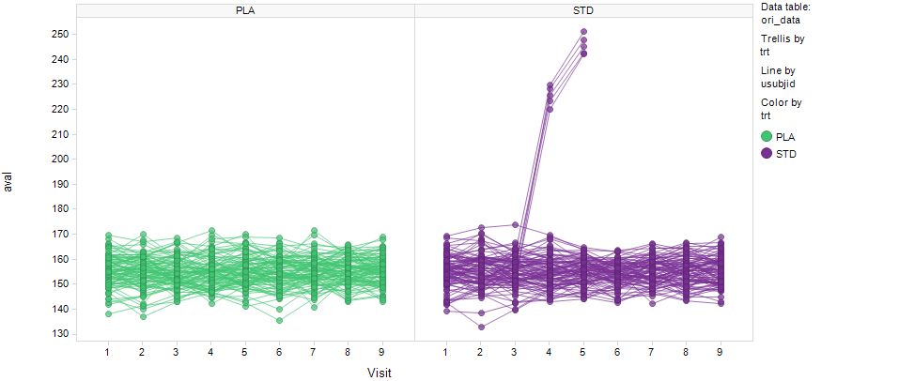
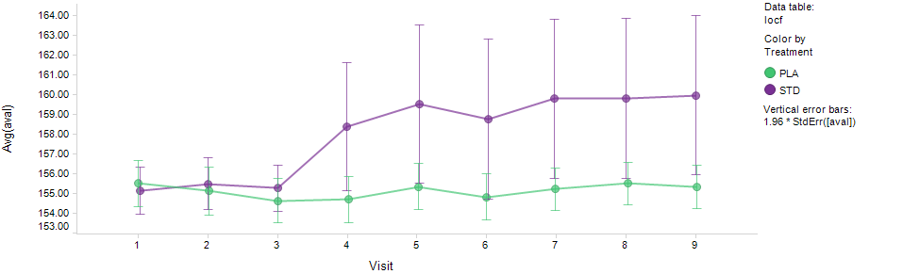
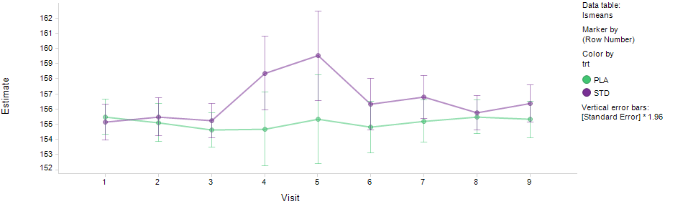
Labs - Interpretation
Observed
LOCF
MMRM
Notes:
LOCF=Last observation carried forward; MMRM = Mixed-Effect Model Repeated Measure
Here’s an extreme example to demonstrate why using group mean data to assess transient/persistent patterns is unreliable. In this example, a small subset of patients went really high, then dropped out (as shown in the spaghetti plot on the left). Observed case data over time - The means reflect an increase, followed by a decrease. LOCF data over time – The means reflect an increase that persists. MMRM - The means reflect an increase, followed by a decrease. It would be incorrect to say this is transient or persistent. The real answer is that we don’t know what would have happened if those patients remained in the study.

Slide 67
Questions?

Slide 68
Medications – The List (from demographics, disposition, medications white paper)
Study Drug vs Placebo
Summary of prior medications – preferred names
Summary of concomitant medications – preferred names
During Study Drug and During Study Drug+After
None
Percentages
Notes:
Study drug vs placebo list from the PhUSE demographics, disposition, medications white paper. Multi-period studies were not in scope.

Slide 69
Medications – Rationale
Study Drug vs Placebo
Understand the population under study more
Assess whether there is an imbalance in medication use that would be important to know when reviewing safety data
During Study Drug and During Study Drug+After
None

Slide 70
Medications - FAQs
Since you don’t recommend a summary of concomitant medications beyond the controlled treatment period, why collect medications during open-label or off-treatment periods?
  Could be important for individual case reviews
  Patient profiles include the time course of study drug and concomitant medications with the time course of adverse events, laboratory measurements, etc.
Common pitfall: Forgetting about the all-important patient profile. Just because data might not be used in a table, figure, listing in a study’s List of Analyses doesn’t mean it isn’t important for individual case reviews.
Notes:
Consider the patient profile (whether it’s done graphically or via a listing) an a-priori TFL needed for planning purposes.

Slide 71
Medications - FAQ
Why do you recommend summaries using preferred names instead of ATC codes?
  See the demographics, disposition, medications white paper for a thorough discussion
  The same medication can be mapped to different ATC codes depending on reported intended use (unlike MedDRA that has primary mappings defined)
    Not ideal for the intended purpose of the summary table

Slide 72
Disposition
There’s a recommended listing of subjects who discontinue due to physician decision, withdrawal by subject, withdrawal by parent/guardian, or other
  See the demographics, disposition, medications white paper for a thorough discussion
  Provides assurance that these subjects discontinued for reasons unrelated to adverse events or efficacy (by listing what is entered in a “specify” field)
    Prevents the need for defining these subjects as “notable”
Notes:
Excerpts from demographics, disposition, medications white paper:
Prevention of missing data has gained a fair amount of attention recently (National Research Council 2010, O’Neill and Temple 2012). Discontinuation of treatment without a clear reason is considered “missing” information. When a vague reason is cited as a reason for discontinuation (e.g., physician decision, withdrawal by subject, withdrawal by parent/guardian, or other), follow-up is generally required to determine if a more specific reason (e.g., adverse event, lack of efficacy) would be more appropriate. Even when such follow-up occurs, there are often a number of subjects with such vague reasons that exist in the data. Additional information (e.g., via a “specify” field) can be reviewed to provide assurance that the reason is unrelated to safety or efficacy. As described in Section 7, a listing is recommended for this purpose. A specify field (or some alternative) would be required during collection to be able to create the listing.
Listing 7.1 is recommended as a means to provide assurance that those who listed physician decision, withdrawal by subject, withdrawal by parent/guardian, or other as the reason for discontinuation were truly unrelated to an adverse event or lack of efficacy. Such a listing requires a textual description (e.g., “specify” field) to be collected when one of the less specific reasons is checked. Although such reasons are specifically reviewed for adverse events or lack of efficacy during data collection and monitoring, sponsors of a clinical trial may be in the position to provide more specific documentation of the true reason.

Slide 73
Integrated Summaries
See white papers for recommendations
  Many recommended displays are similar to those for individual studies, except with different statistical methods (eg, stratification by study)
  Out-of-scope for this workshop
  Upcoming workshop and/or additional educational videos are planned
See educational video on study-size adjusted percentages
  Go to phuse.eu, click on Working Groups, click on PhUSE references, go to the Standard Analyses and Code Sharing Section, click on “Topics for pooling data from multiple studies”
Common pitfall: Using improper methods when pooling data from multiple studies

Slide 74
Summary
Safety planning and interpretation is not easy
  Requires expertise not usually obtained prior to joining a team
  Requires intermediate to advanced scientific thinking
    Keep the purpose of the display in mind
    Think about what you are estimating
    Keep any comparisons unbiased as possible
  Requires cross-functional discussion
Improve your safety analytics expertise – read guidance/papers
Get Engaged!
  Review draft white papers
    Version 2 of labs white paper is under development
    Safety topics of interest white paper in development

Slide 75
Questions?

Slide 76


Slide 77
SACS Working Group Vision
Vision: Leverage crowd-sourcing to improve the content and implementation of analyses for medical research, leading to better data interpretations and increased efficiency in the clinical development and review processes

Slide 78
SACS Working Group Goals
Where gaps exist, develop recommendations for analyses and displays in areas that could benefit from crowd-sourcing
Establish and maintain a publicly available repository for storing program code to be used as analytical tools for medical research
Where gaps exist, develop code for recommended analyses and displays that could benefit from crowd-sourcing (to reside in the repository)
Where gaps exist, develop guidance for good programming, quality, and validation practices

Slide 79
Current Projects
Analysis and Display White Papers (ADW)
Lead: Mary Nilsson
Communication, Promotion, Education (CPE)
Leads: Wendy Dobson, Jared Slain
Macro Development
Lead: Ninan Luke
Code Sharing (Repository)
Leads: Hanming Tu, Bob Friedman, Gustav Bernard
Best Practices for Quality Control and Validation
Leads: Maria Dalton and Jane Marrer
Test Data Factory
Lead: Peter Schaefer

Slide 80
ADW Project Team Vision
Trial Design
Data Collection Systems
Observed Datasets
Analysis Datasets
Tables, Figures and Listings
Clinical Data
Flow
Industry
Standards
Alignment
No Standards
PRM
CDASH
SDTM
ADaM
PRM = Protocol Representation Model
CDASH = Clinical Data Acquisition Standards Harmonization
SDTM = Study Data Tabulation Model
ADaM = Analysis Data Model

Slide 81
ADW - Planned Deliverables
White Paper | Public Review Target
ADW style guide | NA
General output tips and considerations | Q3 2019
Safety topics of interest | Q3 2019
Labs | Q3 2019
Vitals | Q4 2019
Questionnaires | Q4 2019
Hepatotoxicity | Q4 2019
Listings in CSRs and submissions | Q1 2020
Treatment emergent definitions | Q1 2020
Interactive displays for clinical safety data | Q2 2020
ECGs | Q3 2020

Slide 82
ADR Evolution
1994 ICH E2A: In the pre-approval clinical experience with a new medicinal product or its new usages, particularly as the therapeutic dose(s) may not be established: all noxious and unintended responses to a medicinal product related to any dose should be considered adverse drug reactions. The phrase "responses to a medicinal products" means that a causal relationship between a medicinal product and an adverse event is at least a reasonable possibility, i.e., the relationship cannot be ruled out.
1995+ CIOMS III and V: Avoid including events, especially minor events, that have had no well-established relationship to therapy. As previously noted, the primary focus of the CCSI should be the description of adverse reactions. However, the Working Group felt that it could be useful to include a tabulation of the most frequently reported adverse events by drug compared with placebo.
2006 FDA ADR Guidance: For purposes of prescription drug labeling and this guidance, an adverse reaction is an undesirable effect, reasonably associated with the use of a drug, that may occur as part of the pharmacological action of the drug or may be unpredictable in its occurrence. This definition does not include all adverse events observed during use of a drug, only those for which there is some basis to believe there is a causal relationship between the drug and the occurrence of the adverse event.

Slide 83
ADR Evolution (continued)
2010 FDA Clinical Review Template: Adverse reaction refers to an undesirable effect, reasonably associated with the use of a drug, that may occur as part of the pharmacological action of the drug or may be unpredictable in its occurrence. This term does not include all adverse events observed during or after use of a drug, only those for which there is some basis to believe there is a causal relationship between the drug and the occurrence of the adverse event.
2012 FDA guidance on safety reporting requirements: An adverse reaction means any adverse event caused by a drug. Adverse reactions are a subset of all suspected adverse reactions where there is reason to conclude that the drug caused the event.
2017 PhUSE AE white paper: An undesirable effect, reasonably likely to be caused by a study drug and it may occur as part of the pharmacological action of the study drug or may be unpredictable in its occurrence.

Slide 84
Adverse Events - FAQs
Why does the table with maximum severities not have confidence intervals for the mild and moderate rows?
  Relates to the primary purpose of the table – checks that we don’t miss a signal if we focus on the more severe events
  Comparing percentages between treatments of exactly mild and exactly moderate are not generally clinically useful comparisons

Slide 85
Adverse Events - FAQs
Why do you recommend 2 ways of sorting for TEAEs, but not SAEs and AEs leading to study treatment discontinuation?
  Trying to balance right-sizing TFL volume and value the extra TFL brings
  The TEAE list is usually quite long, so benefits more for 2 ways of sorting

Slide 86
Adverse Events - FAQs
Why didn’t you include a summary of AEs leading to study (as opposed to study treatment) discontinuation?
  Disposition tables will include summaries of reasons for discontinuing study treatment and reasons for discontinuing study
  For specific AEs (eg, MedDRA PTs), only interested in those AEs leading to study treatment discontinue (which is in the recommendations)
    AEs leading to study discontinuation not as meaningful for safety signal detection
Notes:
AE = Adverse event

Slide 87
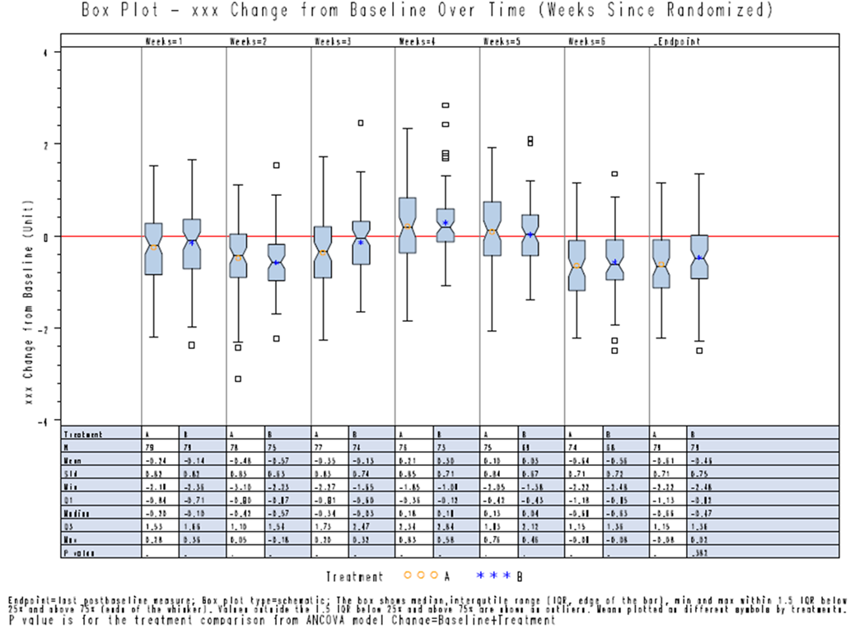
Labs – Treatment Period Shell – Boxplot Change
Notes:
Notes provided for observed boxplot also apply to this boxplot

Slide 88
Labs - FAQs
Are measurements collected at an early discontinuation visit considered planned or unplanned?
  Conceptually, they are planned measurements. However, for labs collected only on occasion, inclusion of such measurements often disrupts the ability to see trends over time.
    Recommend change to last observation include the measurement
    Recommend observed and change summaries by visit only keep planned visits per schedule of events
Notes:
See also PhUSE white papers – central tendency and outliers/shifts

Slide 89
Labs - FAQs
Why are shifts to high/low summaries based on thresholds as opposed to changes?
  Conceptually, a case could be made that shift summaries using meaningful changes (instead of thresholds) would be more useful for signal detection for lab data, however they are not available
    It’s unclear whether such an initiative would add sufficient value versus alternative ways of looking at the data

Slide 90
Labs - FAQs
Instead of boxplots of changes over time, wouldn’t analyses of maximum change fit better with the purpose of signal detection?
  Probably - We may update the recommendations
    Easier to incorporate a meaningful objective measure of imbalance between treatments
  Max change is recommended for integrated summaries
    By visit summaries do not work well for integrated summaries as visit schedules are usually different across studies
    Having analyses of max changes for integrated, and by visit summaries for individual studies provides a nice overall package

Slide 91
Vitals and ECGs
Most of what we covered for labs applies to vital signs and quantitative ECGs
  One exception – shift tables are not recommended when shifts to high/low include a threshold and a change value (which is often done for several vital signs/ECGs)
Notes:
Excerpt from PhUSE lab white paper:
Of note, shift tables become complex to create and are difficult to interpret if the definition of an outlier/shift includes a specified change or percent change value. Thus, creating the shift table is not recommended in these cases.

Slide 92
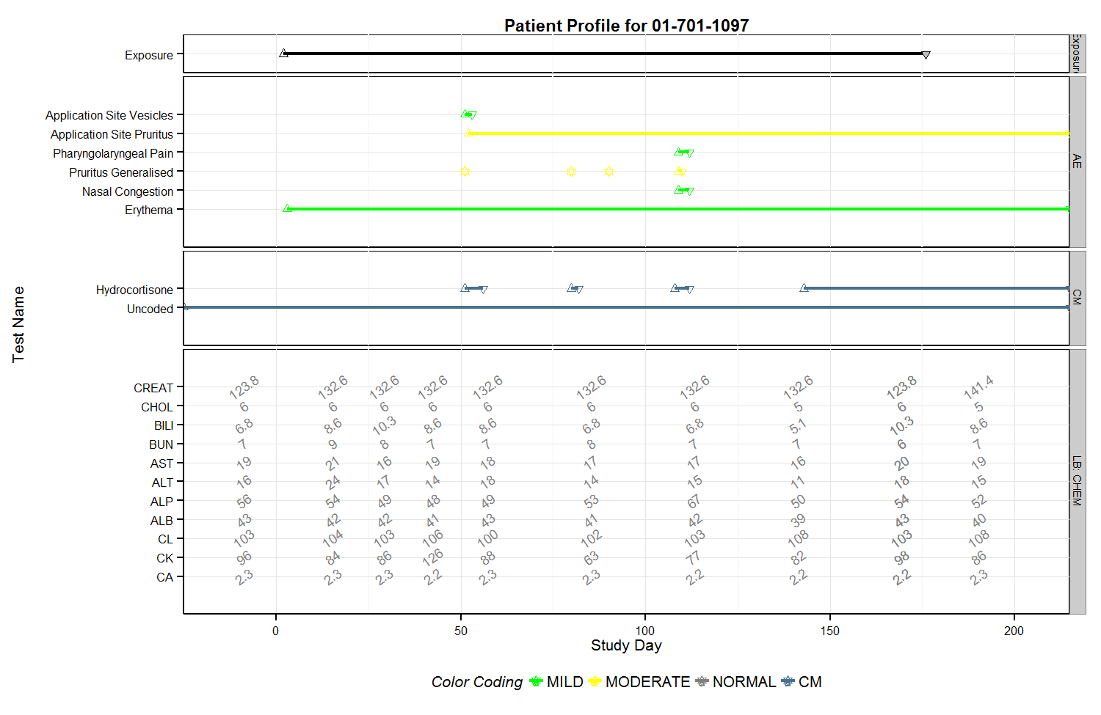
Patient Profile – Example (showing only 1 of 4 pages)

